Slide 1
SIMD INTERCONNECTION NETWORKS

Slide 2
SIMD INTERCONNECTION NETWORKS
Static versus dynamic network
2. Mesh-connected Illiac network
3. Cube interconnection networks

Slide 3
Static Vs Dynamic Networks
The topological structure of an array processor is mainly characterized by the data routing network used in interconnecting the processing elements.
Static networks
Topologies in static network can be classified according to the dimensions required for layout. ie one-dimensional, two-dimensional, three-dimensional
Examples for one dimensional topology :- linear array.

Slide 4
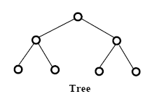
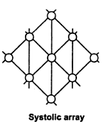
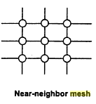
Two dimensional topology :- ring, star, tree, mesh, and systolic array.

Slide 5
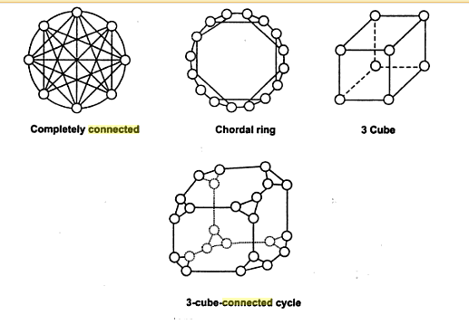
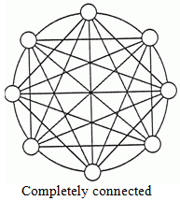
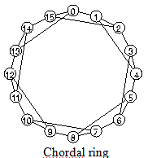
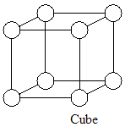
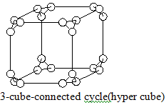
Three dimensional topologies include completely connected chordal ring, 3 cube, and 3 cube connected cycle networks (hyper cube).

Slide 6
Dynamic Networks
Single-stage Vs Multi-stage
Single-stage networks
A switching n/w with N input selectors (IS) & N output selectors (OS)
IS is a 1-to-D demultiplexer & OS is an M-to-1 multiplexer
Single-stage n/w is also known as recirculating n/w
Data items may have to recirculate through the single stage many times before reaching final destination

Slide 7
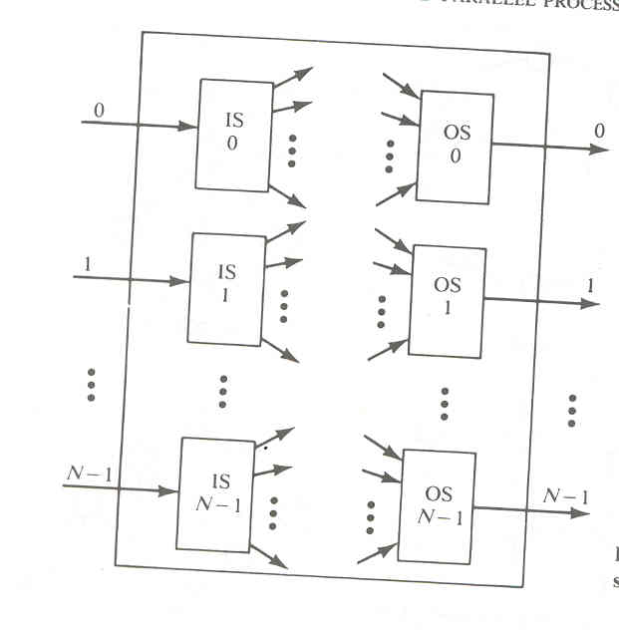
Single stage interconnection n/w

Slide 8
Multistage networks
Multistage networks are described by 3 features :
switch box, n/w topology, control structure
Switch box is an interchange device with 2 i/p & 2 o/p
Multistage networks are divided into 2
One-sided n/w & two-sided n/w
Two sided n/w is divided onto 3
Blocking, Rearrangeable, Nonblocking

Slide 9
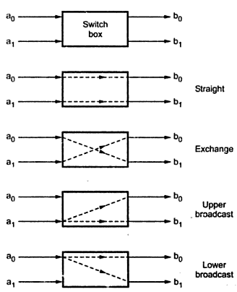
A two-by-two switching box and its four interconnection states

Slide 10
Two-sided multistage n/w
Blocking n/w
Simultaneous connections of more than one terminal pair may result in conflicts in the use of communication links
Eg: omega, flip, n cube, baseline network
Rearrangeable n/w
n/w that perform all possible connections b/w inputs & outputs by rearranging its existing connections, so that a connection path for new I/O pair can be established
Eg : Benes network
Nonblocking n/w
n/w which can handle all possible connections without blocking
Eg : Clos network

Slide 11
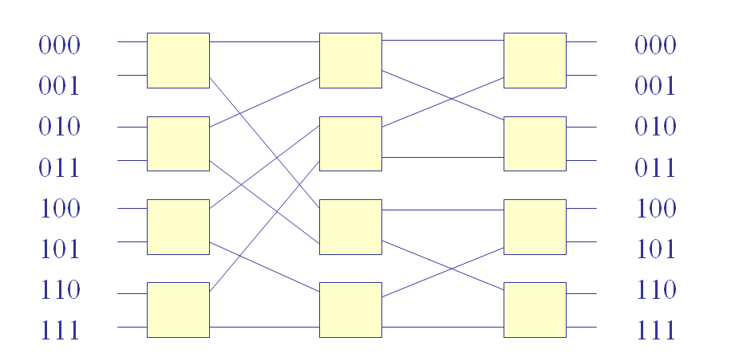
8 8 Baseline network

Slide 12
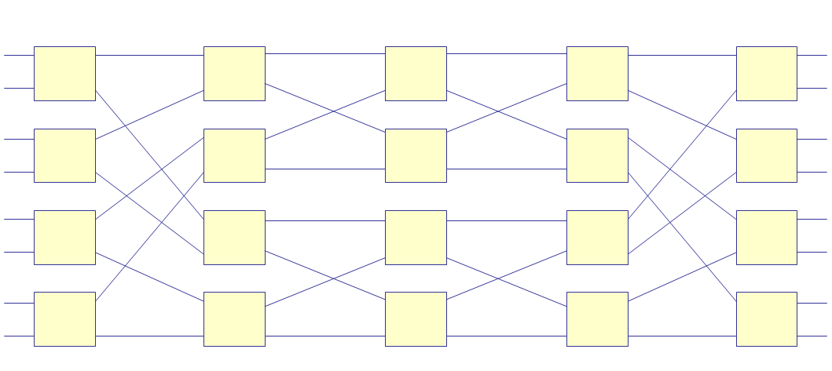
8 8 Benes network

Slide 13
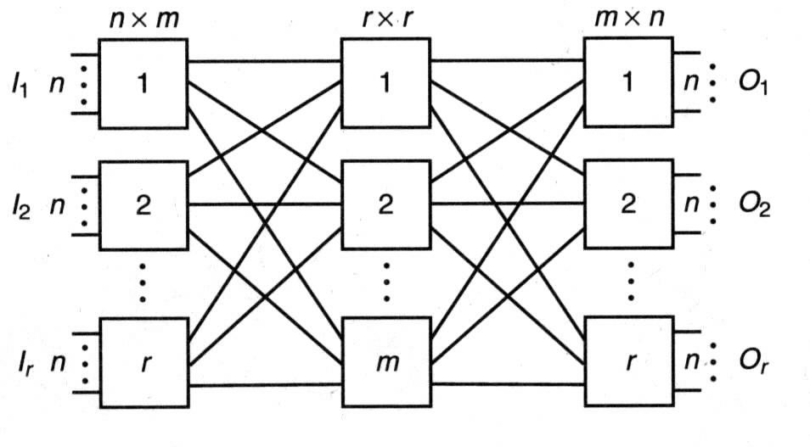
Clos network

Slide 14
A multistage n/w consists of n stages
N=2^{n} , N: no. of I/O lines
Each stage use N/2 switch boxes
Each stage is connected to next stage by at least N paths
Control structure determines how the states of switch boxes will be set
Individual stage control
Individual box control
Individual stage control uses same control signal to set all switch boxes in the same state ie, all boxes set to same state
Individual box control uses separate control signal to set the state of each switch box, different state

Slide 15
2) Mesh-Connected Illiac Network
A single stage recirculating network has been implemented in Illiac IV array processor
Communication is possible only between the neighboring nodes.
The output of IS is connected to the inputs of OS.
Each PE_{i} is allowed to send data to PE _{i+1},PE _{i-1},PE,_{i+r} PE_{i-r} where r=√N.
Eg: Illiac IV array processor, N=64 , r= √64=8
N, is the number of processing elements PE

Slide 16
Routing functions..
Formally Illiac network is characterized by following four routing functions.
R₊₁(i) = (i +1)mod N
R₋₁(i) = (i -1) mod N
R_{+r}(i)= (i +r) mod N
R_{-r}(i)= (i -r) mod N
Outputs of IS_{i} are connected to inputs of OS_{j} for j=i + 1, i – 1, i + r , i – r
OS_{j} gets its inputs from IS_{i} for i= j – 1, j + 1, j – r, j + r

Slide 17
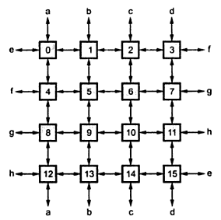
Mesh connections

Slide 18
Each PE_{i} is directly connected to its 4 nearest neighbors in mesh n/w
Permutations for N=16, r=4
Horizontally ,all the PE’s of all rows form a linear circular list as governed by the following 2 permutations.(Each with a single cycle of order N)
R+1=(0 1 2….N-1)
R-1=(N-1….2 1 0)
Vertically, the shift by a distance of 4 is characterized by the following permutations(each with 4 cycles of order 4 each)
R₊₄=(0 4 8 12)(1 5 9 13)(2 6 10 14 )(3 7 11 15)
R₋₄=(12 8 4 0)(13 9 5 1)(14 10 6 2 )(15 11 7 3)
Eg : consider mesh 5, i =5, r =4,the four neighbor connections are
6 (5 + 1) : (i + 1)
4 (5 – 1) : (i – 1)
9 (5 + 4) : (i + r)
1 (5 – 4) : (i – r)

Slide 19
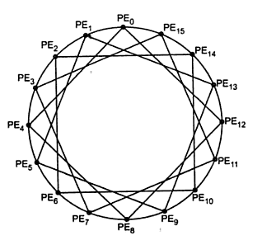
Mesh redrawn

Slide 20
It should be noted that when either R₊₁ or
R₋₁ routing function is executed, data is routed only if all PE’s are active
When the routing function R_{-r} or R_{+r} is executed, data is routed only if PE_{i+kr} where 0≤k≤r-1 are active for each i.
Shifting operation in a cycle is suspended if any PE required in the cycle is disabled
Eg : cycle (1 5 9 13) will not be executed if one or more among PE₁ , PE₅ , PE₉ , PE₁₃ is disabled
Illiac is a partially connected n/w
If PE₀ is the source code, PE₁ , PE₄ , PE₁₂ , PE₁₅ is reachable in one step from PE₀ & PE₂ , PE₃ , PE₅ , PE₈ , PE₁₁ , PE₁₃ can be reached in 2 steps and others in 3 steps –PE0 &PE6,PE7,PE9,PE10

Slide 21
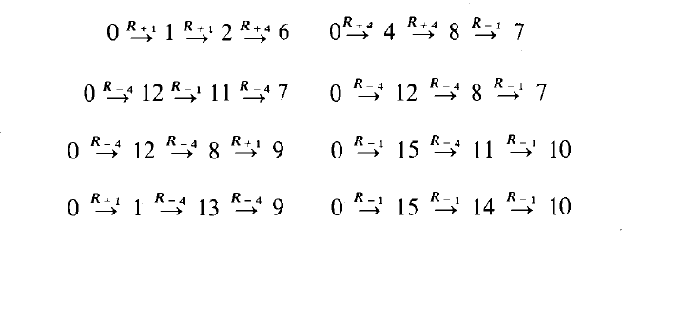
In the worst case of three routing steps, the following eight routing sequences take place in the network.

